Slide 1
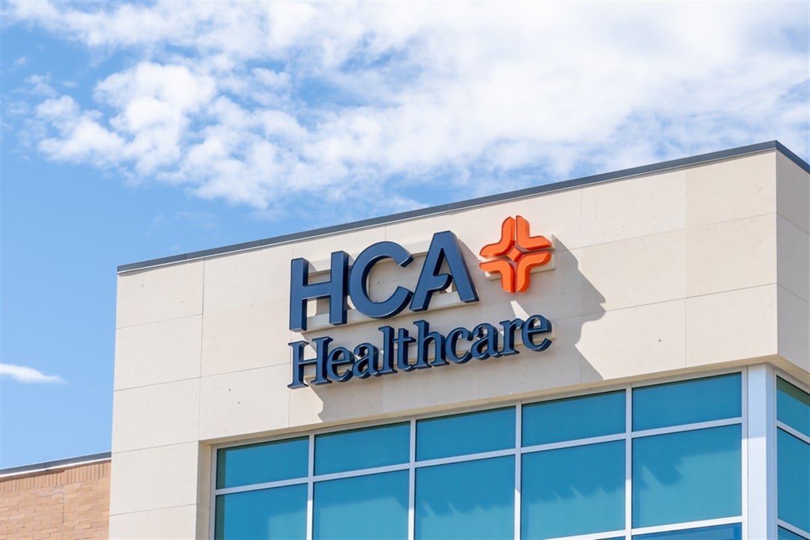

HCA Healthcare (NYSE:HCA)
Long Pitch (100.88% Upside, $543.74 Price Target)
Arnav Sethi, Ryan Qian, Clement Ho
January 11th, 2024

Slide 2
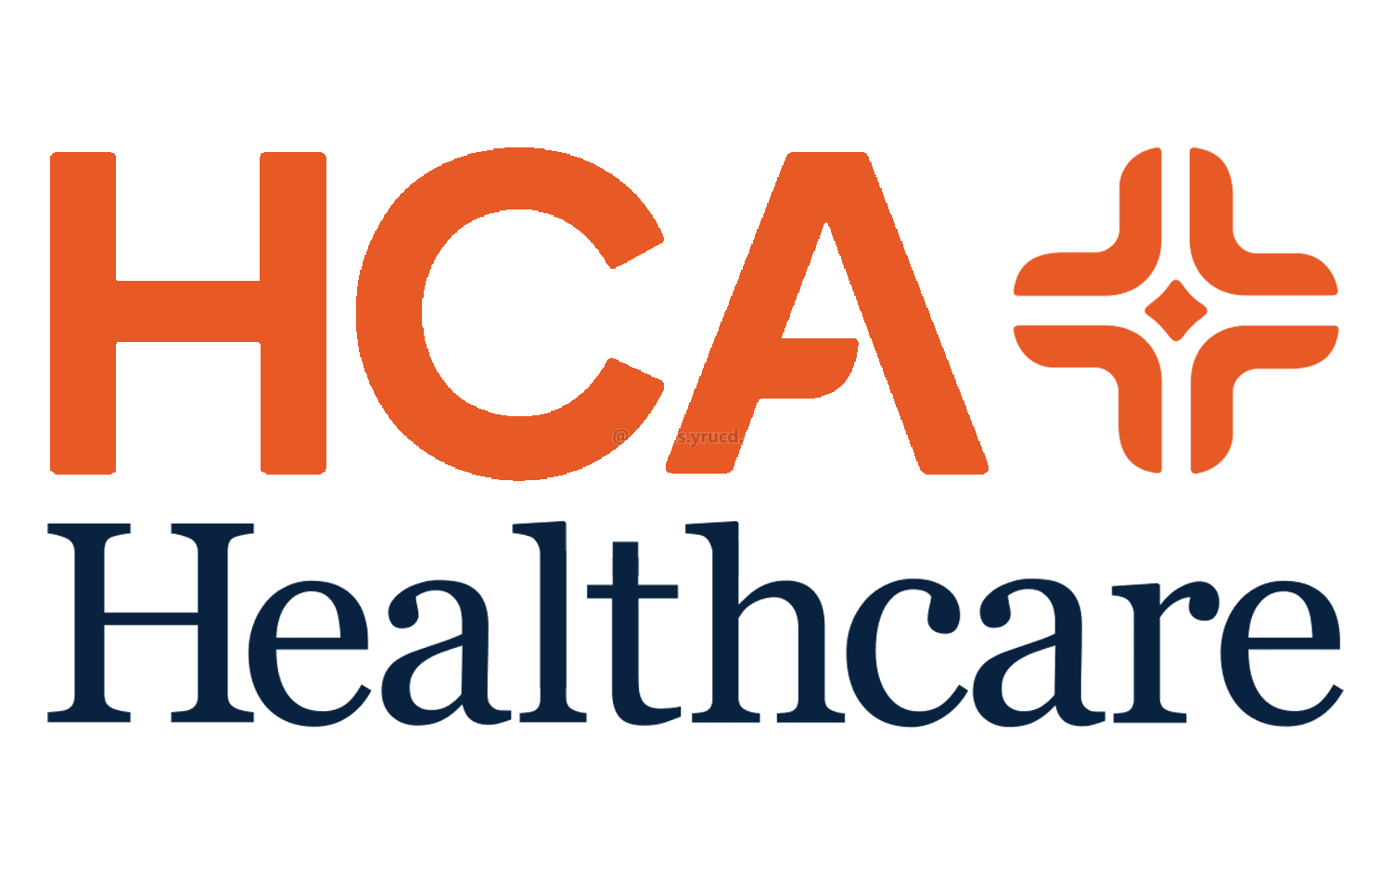
HCA Healthcare Investment Overview
HCA faces pressure from labor and regulatory shifts, remaining resilient with strong growth potential in key markets
The Opportunity
Operational Headwinds causing street to underweight KPI tracking: Recent cyber breaches and natural disasters in core markets have disrupted service and elevated earnings volatility, causing bearish investors to disregard positive industry KPIs
Rising nurse and physician wages constrain operating leverage: Labor intensity is >47% of revenue, temporarily eroding incremental margin expansion despite historical efficiencies underpinned by scale in an economic model unique to HCA
Strong population growth in key states: Texas and Florida (CAGR >1.2%), coupled with an aging demographic, drives high-single-digit procedure volume growth, bolstering revenue resilience despite broader macro and structural headwinds
Strong demand for ambulatory outpatient care centers: HCA’s higher-margin inpatient revenue base serves as a windfall for strategic CapEx redeployment (~6% of revenue) to outpatient initiatives with the potential to establish a
Investment Thesis
1
HCA’s leading presence in the Sunbelt region, America’s largest growing market, poises it to capitalize significantly on demand for outpatient services in coming years, bolstered by an aging majority Baby Boomer/Gen X population in need of long-term care
2
The competitive moat presented by HCA’s economies of scale has been overlooked by investors, resulting in a significant undervaluation of initiatives such as disaster prevention or talent acquisition; major risks are priced in, but key mitigants are not
\
3
Street underestimates HCA’s diverse payer and geographic mix, a key catalyst to consistent price appreciation that hedges against regulatory risk alongside providing industry-leading growth opportunity in expanding Sunbelt markets Texas & Florida
HCA Healthcare presents an attractive risk/reward at XX NTM EV/EBITDA, with EPS compounding at ~12% annually over next 3YY, driven by a strong payer mix, increasing outpatient revenue, and operational moat

Slide 3



Business Overview
HCA Healthcare, Inc. is a leading operator of hospitals and healthcare facilities across the U.S. and the U.K.
Business Overview
Founded in 1968, HCA, headquartered in Nashville, Tennessee, operates as one of the largest for-profit healthcare providers.
Handling over 43 million patient encounters annually, HCA Healthcare owns and operates 188 hospitals, 123 freestanding outpatient surgery centers, and a network of physician offices, urgent care clinics, and emergency rooms across 20 U.S. states and the UK.
HCA generates revenue from inpatient and outpatient services, physician care, and specialized treatments, funded by private insurance, Medicare, Medicaid, and patient payments, with performance driven by patient volume and payer rates.
52-Week Stock Chart
Key Financials & Revenues by U.S. Region
Ticker | NYSE: HCA
Share Price | $302.15
Enterprise Value | $122.99B
Market Cap | $80.99B
LTM EV/EBITDA | 8.78x
6.9% CAGR
Operating States
Timpani
Augmedix Go
Nurse Handoff
SCTCT Network
Western (5%)
Central (28%)
Eastern (32%)
Clinical labour management platform
Documentation tool for capturing visit conversations
AI-driven technology with Google Cloud to auto-generate reports
Largest cellular therapy network for blood cancers
Texas &
Florida (34%)
Sources: Company Filings, Capital IQ, Tradingview

Slide 4
I.
Business Overview
& Analysis

Slide 5

Internal Analysis: Management and Ownership
HCA holds many advantages which make it a strong player in the industry
Leadership
Ownership
Sam Hazen
CEO of HCA Healthcare
Institutional
61.10%
Top Holders | Ownership %
The Vanguard Group, Inc. | 6.32%
BlackRock, Inc. | 6.11%
Sanders Capital | 4.56%
State Street Corporation | 3.28%
Wellington Management | 2.78%
First Eagle Investment Management | 1.77%
(0.52% Ownership of HCA)
Sam Hazen, CEO since 2019, brings over 36 years of operational and financial expertise to the company, overseeing one of the nation’s largest healthcare providers with 179 hospitals and 2,000 care sites, delivering 5% of all U.S. hospital services.
Business Efficiency
Insiders 28.42%
HCA’s focus on business efficiency is evident through strong workforce retention, significant investments in employee training, and a growing talent pipeline. These efforts help maintain operational strength and support long-term growth.
Public & Others 10.48%
Sources: Company Filings, Capital IQ, Forbes, Yahoo Finance

Slide 6
External Analysis: Competitive Landscape & Trends
Competitive Strengths Driving Sustainable Growth
Scale Creates Overlooked Strategic Advantages
HCA Healthcare’s large network of 1,800+ facilities enables cost efficiencies, favorable supplier negotiations, and significant regulatory compliance investments, creating a competitive advantage.
Meaningful Buybacks
Geographic and Payer Diversity as a Growth Catalyst
HCA’s strategic presence in Texas and Florida, combined with a diverse payer mix, drives revenue growth and mitigates regulatory risk, capitalizing on demographic trends and rising healthcare demand.
HCA’s significant buybacks demonstrate confidence in business fundamentals and a commitment to shareholder returns.
Sources: Company Filings, Capital IQ, Tradingview

Slide 7
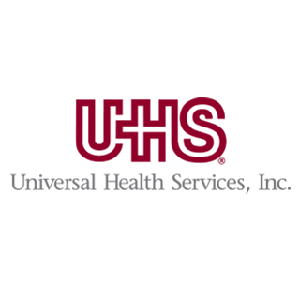
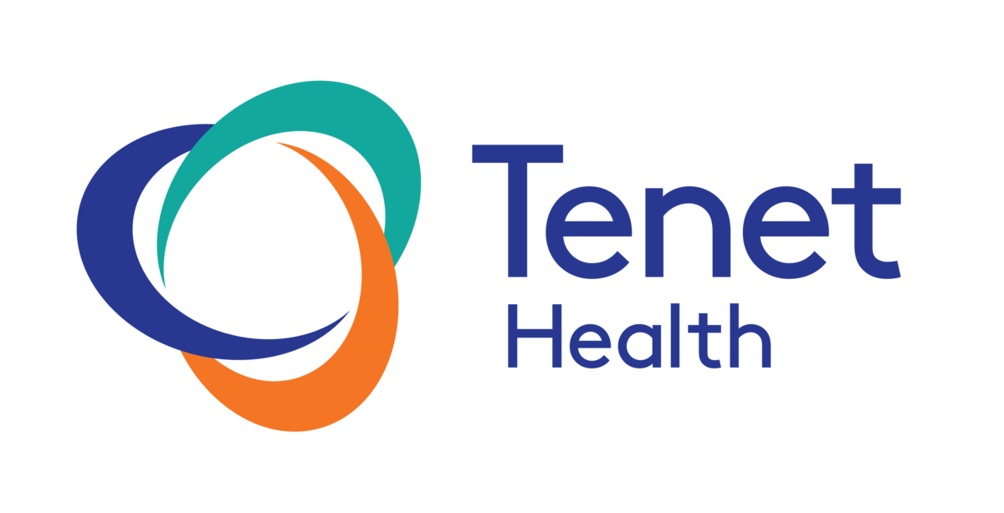







External Analysis II.
Comparable Companies Overview
Big Players
Target
Impact on HCA
Key Differentiator
Growth Potential
Broad geographic presence and dominance in acute care and specialty services.
Forces HCA to expand service offerings and strengthen its competitive positioning in urban markets.
Moderate: Expansion relies on acquisitions and market saturation in established regions.
Established scale and strong payer relationships.
Mid-Market
Focused on affordability and regional accessibility in rural and suburban areas.
Challenges HCA to expand into smaller markets and maintain cost-efficiency to compete effectively.
High: Growing demand for affordable care in underserved areas provides significant expansion opportunities.
Cost-effective models and localized care delivery.
Start-Ups
Technology-driven models and value-based care tailored to specific demographics like Medicare patients.
Pressures HCA to integrate digital health solutions and adopt patient-centric care models to retain market share.
Very High: Rapid adoption of digital health and value-based care offers scalable growth in emerging markets.
Digital-first approach with emphasis on convenience.
Sources: Capital IQ, Deloitte, Persistence Market Research, Morningstar Research, Yahoo Finance

Slide 8
II.
Thesis

Slide 9
Thesis I: Expanding Markets Lead to Bullish Base Case for HCA
An aging and growing U.S. populace is driving demand for healthcare, migrating to key states where HCA operates
Sunbelt Migration
Expanding Outpatient Demand
HCA’s extensive presence positions it to capture a 5-8% annual increase in admissions across 2,500+ care sites, driving revenue growth
HCA’s increasing focus on outpatient services, which currently represent ~35% of total revenue, aligns with trends in key high-growth states, supporting 12% EPS CAGR projections over N3Y, outpacing peers significantly
A 2024 Nucleus study quantifies BETI’s value:
Pollution levels in the Sun Belt, including a 15% rise in PM2.5 over L10Y, are driving increased recurring illnesses, particularly in markets like Texas (43 hospitals) and Florida (50+ hospitals), boosting demand
‘Baby Boomer’ generation (U.S.’ most populous group), is nearing the fully 70+ age range, driving current demand & strong projections for generation X, who are cognizant of outpatient care options that yield higher margins for HCA
The Sunbelt now holds over 50% of America’s age 65-plus cohort
HCA in Nominal Pop. Growth Areas
Projected Growth Isn’t Accurately Priced In
HCA is the largest player in every market highlighted in red
Across Texas & Florida, HCA’s biggest markets:
15.3%
YoY growth in population
25%
of residents will be over 65 by 204
2.1
Beds per 1000 citizens, 27% below national avg.
HCA is poised to grow significantly simply to meet already existing demand
Street underestimates the benefits of HCA’s leading sunbelt presence, and has not priced in growth of outpatient demand
Sunbelt States Non-Sunbelt States
Sources: CDC.gov, HCA Investor Relations, U.S. Census

Slide 10
Thesis II: Operational Ability Provides Agility & Competitive Moat
HCA’s superior margins and scale-based moat result in an agile business ready to efficiently deploy capital
HCA has a leading EBITDA margin of ~19%, compared to the industry average of ~14% and~15% for the market
HCA has acted decisively in the face of threats…
3Q23
HCA experiences a critical data breach affecting 11 million patients
3Q24
Hurricanes make landfall, losing HCA between $200MM-$300MM
3Q24
Mgmt. expresses interest in capitalizing on BETI’s pricing power and industry status in the future
HCA’s margins and FCF provide the financial flexibility to invest in disaster-resilient infrastructure and advanced supply chain systems at a rate higher than competitors
…but street overlooks this, believing that HCA will not be able to overcome risk factors plaguing the Hospital industry at large; leaving HCA’s mitigant abilities not priced into current share price
Resultant high FCF supports investments in outpatient & specialty care with tech advancements, securing long-term profitability.
HCA has invested considerable resources into employee retention, reducing turnover by 46%
Based on conservative estimates of patient volume growth and outpatient service expansion, even as little as a 0.25% annual improvement in EBITDA margin from 2025–2029 cumulatively leads to $1.5 billion in new contributions achieved through operational moat. For reference, 2023 revenue was $60 billion, and the EBITDA margin was 19%. A 0.25% margin improvement is nearly imperceptible operationally but made possible by HCA’s operational excellence, workforce stability, and extensive service network.
New Talent Acquisition Spend
HCA has been able to provide attractive compensation packages at a comparatively lower price to peers by focusing on minimizing turnover
Based on the pricing power of new services and operational efficiencies alone, this strategy will more than offset potential revenue losses from payer mix shifts or natural disaster impacts by 2027—full breakdown in appendix.
Despite short-term turmoil, HCA holds strategic power and will meet growth targets through continual leverage of operational excellence
Sources: Company Filings, Nucleus Research, Capital IQ

Slide 11
Thesis III: HCA is Safeguarded Against Regulatory Changes
Street underestimates HCA’s diverse payer and geographic mix, a key catalyst to consistent price appreciation
Revenue Diversification and Regulatory Resilience
By balancing revenues across private insurance (49%), Medicare (23%), and Medicaid (16%), and uninsured patients (8%), HCA reduces dependence on any revenue stream; providing stability against policy change, particularly government reimbursement rates
State-by-state diversification hedges against risks present from changes in state legislation while enjoying the benefit of shifting resource allocation to high growth areas, HCA is uniquely positioned due to strong geographical diversification and tailwinds from population growth in existing markets
Distribution allows HCA to insulate itself against measures such as ACA expiration and site-neutral, state directed payment
HCA has invested over $600 million in compliance infrastructure and systems, ensuring adherence to key regulation, with over 96% of facilities achieving compliance with value-based care mandates, HCA reduces exposure to penalties and regulatory disruptions
HCA’s Payer & Insurance Distribution
HCA & Competitor Payer Mix
An overreliance on both private and govt. payers is inherently risky; HCA is insulated from both impending Medicare regulation and site-neutral payment
Sources: Yahoo Finance, Wall Street Journal

Slide 12
III.
Valuation

Slide 13
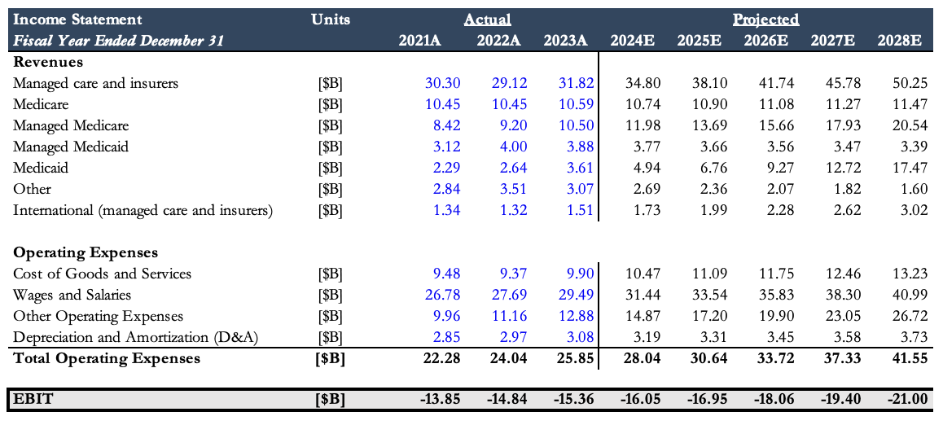
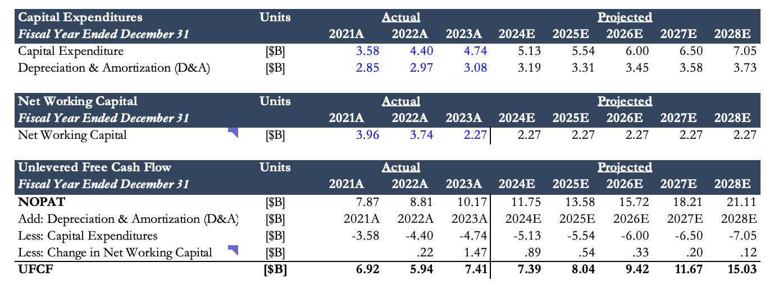
Valuation: Discounted Cash Flow
Revenue and Expense Projection
Revenue and Expense Projection
Sources: Capital IQ

Slide 14
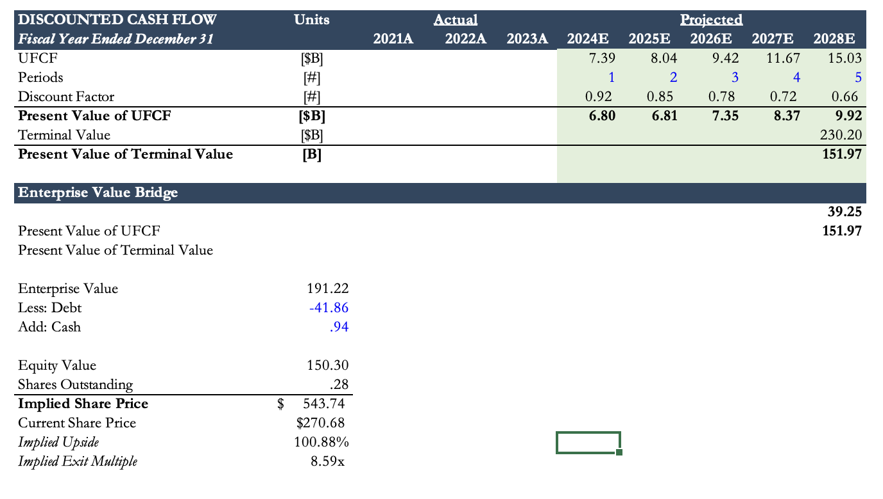
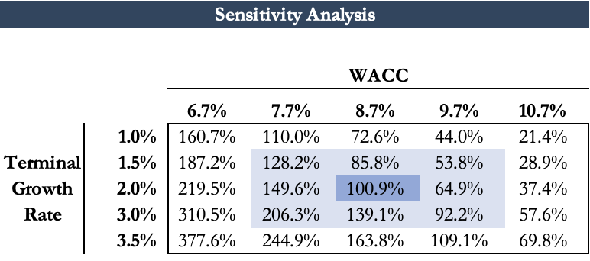
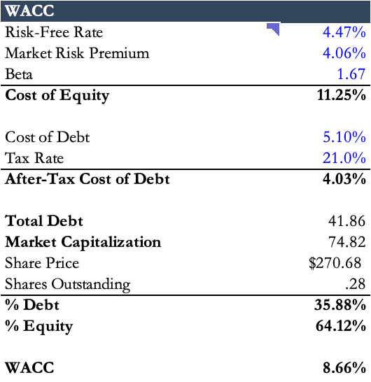
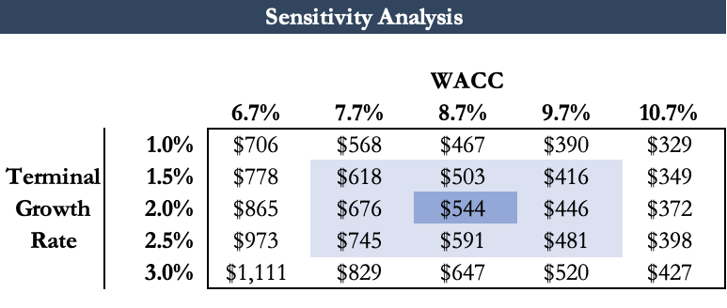
Valuation: Discounted Cash Flow
WACC and Sensitivity
WACC & Sensitivity Analysis
HCA Healthcare current valuation presents attractive upside potential, even with conservative base assumptions.
Sources: Capital IQ

Slide 15
Risks, Mitigations, & Catalysts
HCA Healthcare’s strategies to mitigate risk ensure continued operational resilience and long-term profitability
Major Risks & Respective Mitigants
Regulatory Pressure
Constricted Labor Market
Operational Risks
Changes in regulations, such as adjustments to government reimbursement rates, could affect HCA’s revenue streams and hamper priced in growth projections
The healthcare industry is experiencing major labor shortages, leading to significantly increased labor costs, and highly damaging impacts on outpatient care quality
HCA has proven vulnerable to operational risks such as natural disasters and cybersecurity attacks in the past, causing apprehension on growth targets from the Street
HCA is addressing this risk by expanding managed care networks and negotiating long-term agreements with payers to stabilize reimbursement rates while continuing to diversify revenue streams
HCA implements competitive compensation and partners with educational institutions to develop a robust pipeline of professionals, aiming to alleviate staffing challenges
HCA is leveraging moat to develop disaster response, doubling cybersecurity spend. HCA is also providing a fund to employees in areas afflicted by natural disasters, to continue operations
Growth Catalysts
HCA plans to build new hospitals in key markets, including Texas and Florida, to increase patient access and grow market share in high growth regions
Collaborations with companies like Google Cloud aim to integrate AI into healthcare delivery, enhancing operational efficiency and patient care.
HCA is investing in outpatient facilities and urgent care clinics to meet demand for convenient, cost-effective care, capturing a growing market segment
Yahoo Finance, Mergent Investext. Barron’s, The New York Times

